Slide 1
Music Men

Slide 2
Application Description
The What
A brick-and-mortar music store database
It tracks the inventory and customer info for the store
The Why
It's different
It's potentially useful
It went with the group name

Slide 3
The Data
The database is original; so is the data
The instruments – orchestral candidates
The accessories – whatever we could remember
The people – characters in an old TV show
The orders – Instruments used in the TV show

Slide 4
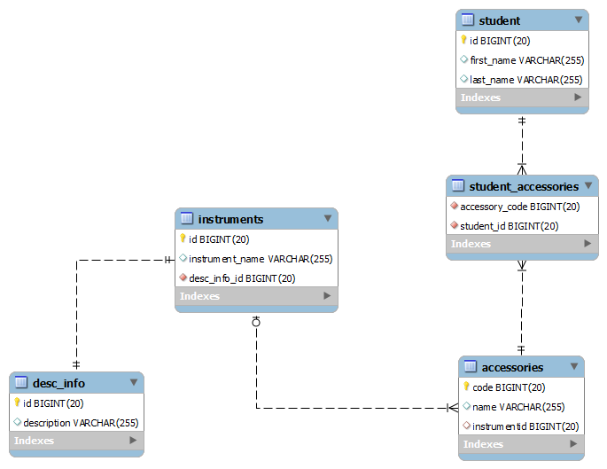
The Database Design

Slide 5
Using Hibernate
Pros
Once setup, you can effectively ignore a completed class (OO friendly)
Cons
Difficult to configure (first-time)
Issues with string-based Foreign Keys

Slide 6
DEMO TIME

